Slide 1


What is Data Science
Dr. Abolfazl Saghafi
Assistant Professor of Statistics
Data Science Program Director

Slide 2
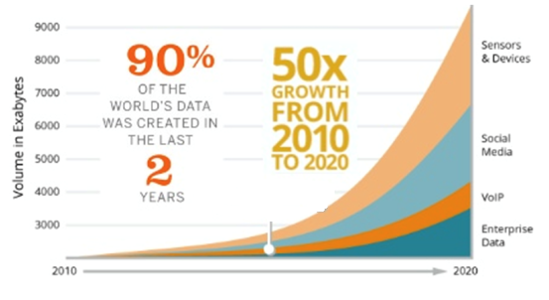
Data Science
Data Science is an interdisciplinary field about scientific methods, processes, and systems to extract knowledge or insights from data in various forms.
In 2020 the world generates 50 times the amount of data generated in 2011. This huge load of data requires expert analysts to extract useful information to help make profitable decisions.
https://data-flair.training
Notes:
What do you think Data Science is?
The traditional process of data analysis is to gather data, which by itself could take some time depending on where the data is stored in what format how large etc., spend some time to analyze and model the data, then report back the results. This whole process could take weeks or months.
Following this process when dealing with BIG data is not feasible, think about a bottleneck, so we need to come up with techniques to resolve issues in each of the mentioned steps to speed up the whole process.

Slide 3
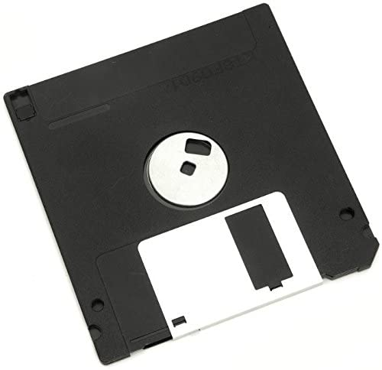

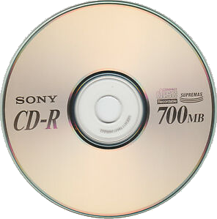
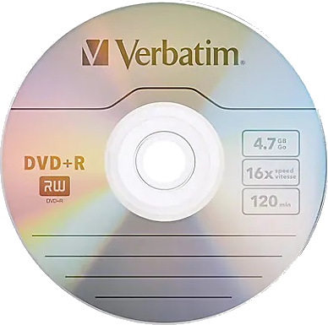
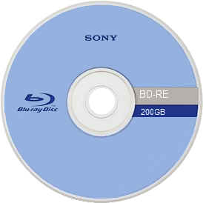

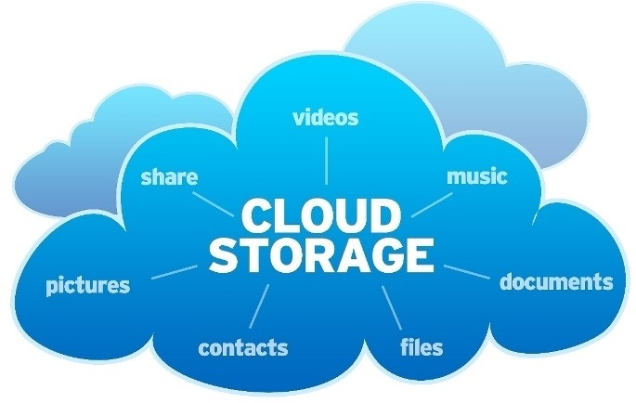
BIG Data Storage and Sharing
Cloud computing offers access to data storage, processing, and analytics on a more scalable, flexible, cost-effective, and even secure basis than can be achieved with an on-premises deployment.
As a cloud user, your data and apps are stored on server space that has been set aside for you, so that data and apps are accessible from anywhere.
Cloud space exists on individual servers found at data centers and server farms around the world.
Notes:
10 years ago, I was using dial-up modem to connect to the Internet which had horrible speed. I used CDs and small flash drives to share data in any form, files, videos, music, anything. Then WIFI technology came and CDs are replaced with DVDs, then BDs and SSDs. Today, majority of people use cloud services.

Slide 4
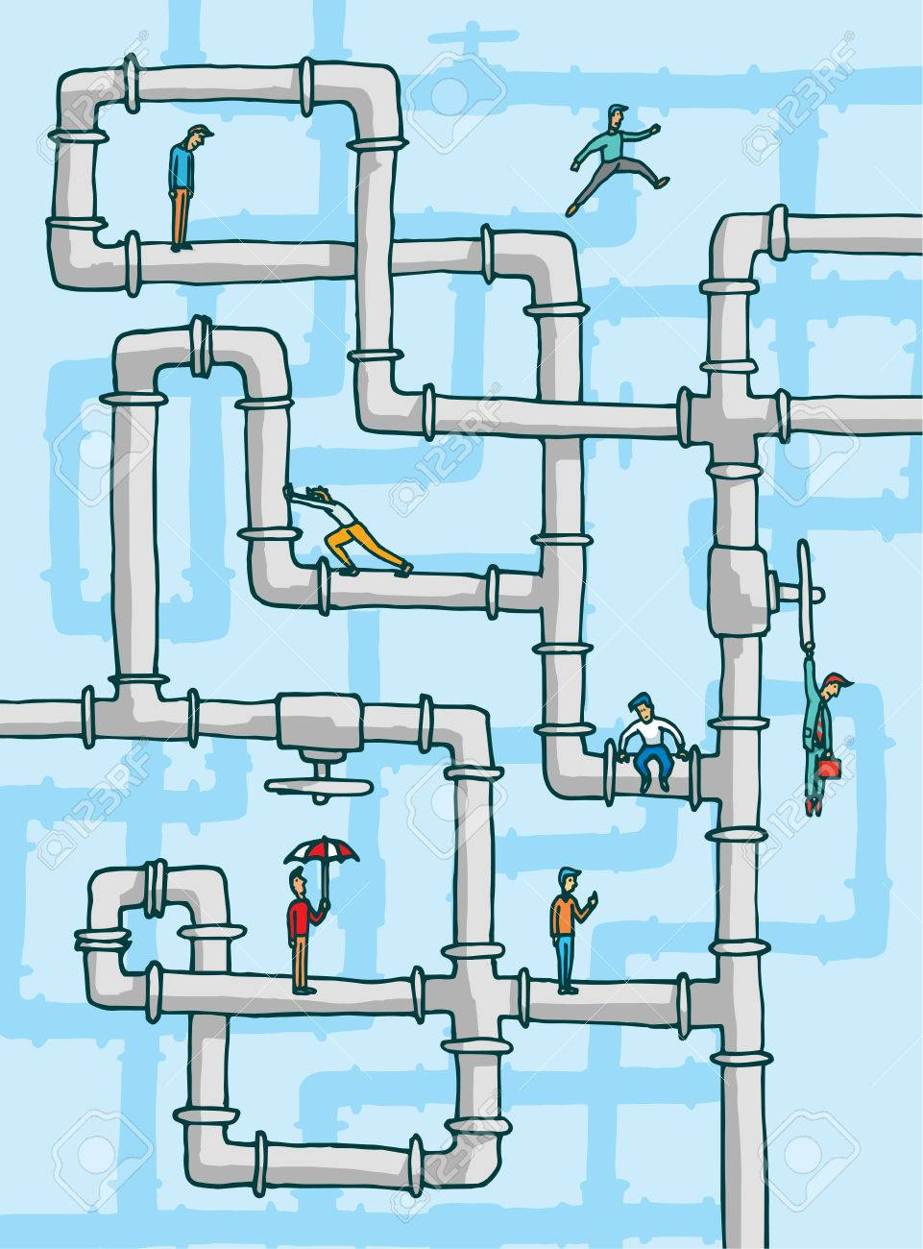
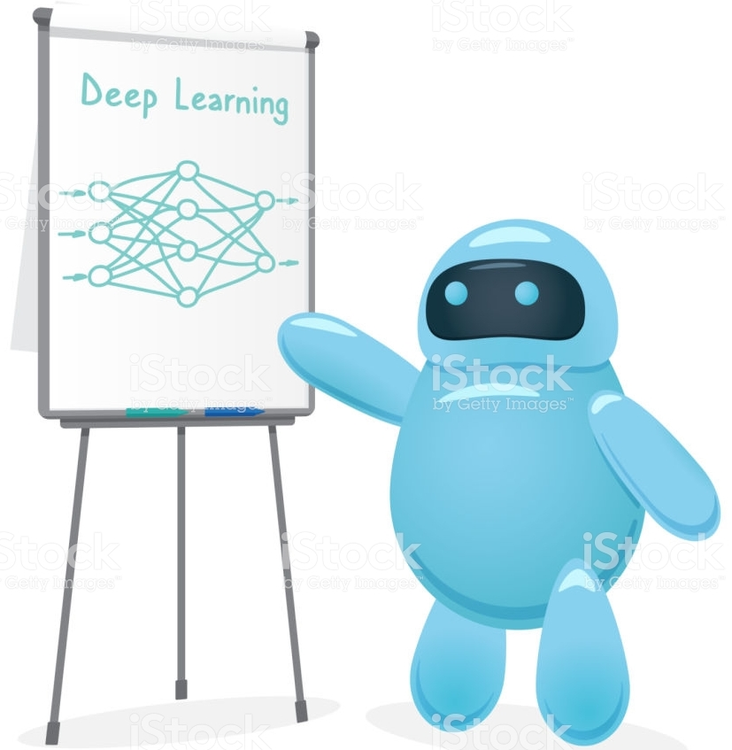
BIG Data Analysis
The solution is automation.
While no amount of automation can entirely displace a properly deployed data science process, automation can make significant inroads in taking the "headaches" out of the data science process.
This whole process is too much for human minds to tackle. Artificial intelligent algorithms could be written to accomplish the enormous task of deriving insight out of chaos.
https://www.123rf.com
https://www.istockphoto.com
Notes:
These type of data can be find everywhere

Slide 5
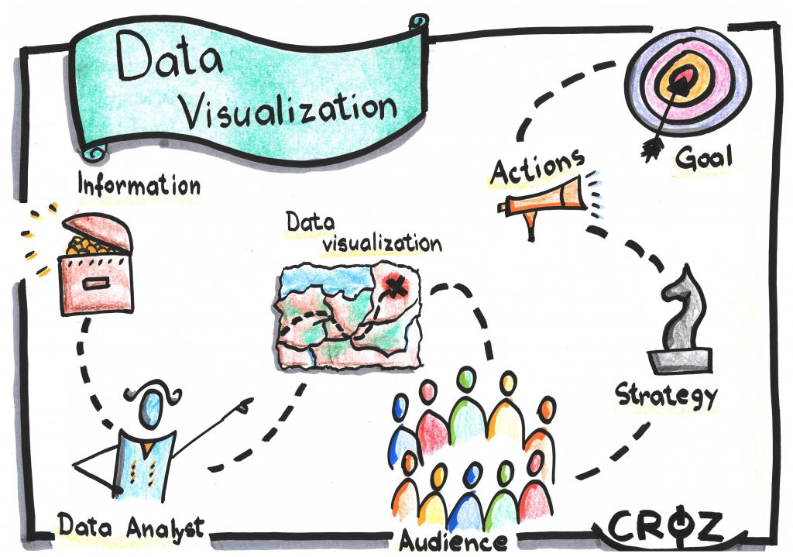
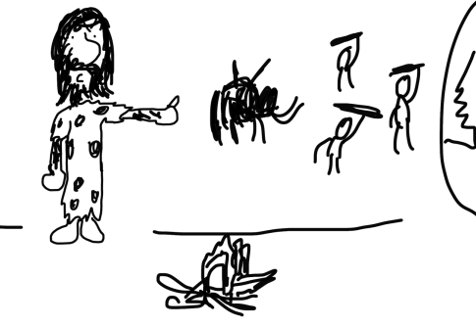
BIG Data Communication
The final stage is communicating the findings to others, usually people who have no idea what many of the analysis means.
https://croz.net
In that sense, the best way to communicate the results is through graphs and charts and images, storytelling also helps. Afterall, we’ve been doing that since stone age!
https://freshspectrum.com

Slide 6

Discussion
What areas and applications of data science are you currently interested in investigating? Rank 3 and explain each. Is there a reason for your selection and ranking?

Slide 7
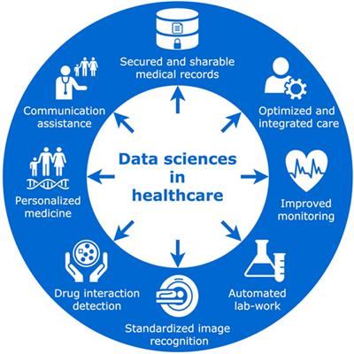
DS in Healthcare
The healthcare sector provides many opportunities with BIG data.
Big health-care data are already a reality; academia, industries, insurance agencies, and public health systems struggle to adapt their infrastructure to a data volume whose size is doubling every 12–14 months [1].
[1] Feinleib D. The Big Data Landscape. Big Data Bootcamp. Berkeley, CA: Apress (2014). p. 15–34.
https://doi.org/10.3389/fpubh.2018.00099

Slide 8
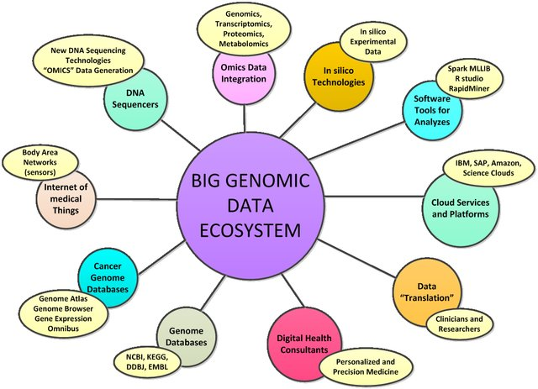
DS in Bioinformatics
Bioinformatics deals with creating innovative methods for processing and analyzing of biological data especially genomic data.
Borovska P., Big Data Analytics and Genetic Research, Conference , Bulgaria, 2017.
Notes:
In silico technologies, as well as next generation sequencing, resulted in exponential grow of experimental data, facing the new challenges of Big data technologies. Many scientific research teams predict that most analyses for the period till 2025 will encompass astronomy, molecular and computational biology, medicine and meteorology, as directions of fundamental science, strongly dependent and influenced by big data technologies.

Slide 9
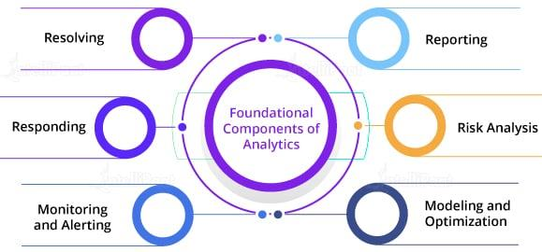
DS in Finance
Over the years, banking companies learned to divide and conquer data via customer profiling, past expenditures, and other essential variables to analyze the probabilities of risk and default. Moreover, it also helped them to push their banking products based on customer’s purchasing power.
One of the major concerns of the financial sector is preventing fraud. Fraud can be the loss of customers’ crucial data, money, invalid claims, fraudulent transactions, and many more.
https://intellipaat.com/blog/data-science-applications-finance/
Notes:
Finance is one of the crucial sectors worldwide. With the advancement in the techniques of Data Science and Machine Learning, the prevention of fraud has become easier.
https://intellipaat.com/blog/data-science-applications-finance/

Slide 10
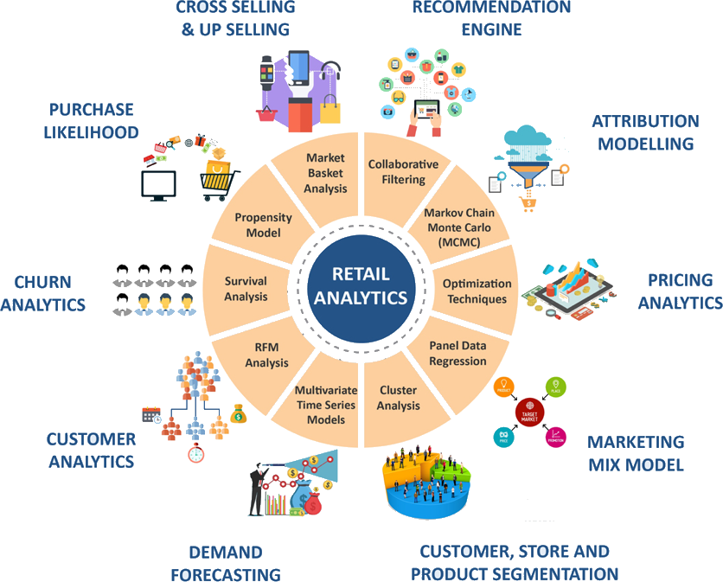
DS in Marketing
Have you ever looked for something online and then found related advertisements on social media and other websites continuously, or got programmatically attacked with undesired advertising emails about the same products?
Well, these are all sweet applications of Data Science …
https://dzone.com/articles/coffee-with-a-data-scientist-tuhin
Notes:
Let’s take a look at the top applications of data science in marketing:
Profiling Audiences/Customers: There are multiple analytics tools enable tracking consumer activity online and allow you to accumulate an array of information about the customer’s interest and activities. All collected information is saved in your ‘user profile’ by the search engine and all the other websites you have visited.
Optimizing Marketing Budget: The central goal of any marketer is to derive maximum ROI from their allotted budgets but achieving this is always tricky and time-consuming and things don’t always go according to plan.
Data scientists have the ability to build a spending model that can help using the budget better by analyzing a marketer’s spend and acquisition data. This spending model can help marketers distribute their budget across channels, locations, and campaigns to enhance their key metrics.
Building a Data-Driven Pricing Strategy: With data science, businesses can use many different analysis techniques to identify their pricing strategy. Some of these include market cost analysis, segmentation, competitor analysis, targeting, individual customer preferences, past purchase history, economic situation, etc.
Identifying the Right Channels: By using the time series models, the data scientists can compare and identify the types of lift seen in various channels. This can be highly beneficial as it shows the marketer exactly which channel and medium are delivering proper returns and giving an adequate lift for the marketer.
Building a Data-Driven Content Marketing Strategy: Data science helps content marketers to deliver the best possible piece of content to customers through their preferred channel, at the time they are most likely to consume the content. Moreover, machine learning can help with crunching all the data for and putting it in a context for digital marketers.
Sentiment Analysis: Businesses can use data science to gain a better understanding of their customer beliefs, opinions, and attitudes. Also, they can monitor how customers react to marketing campaigns and whether they’re engaging with their business or not.
Social Media Marketing: Today’s customers are highly active on social media networks. Data science can be used to tell marketers which leads are exploring their social media page, what content they clicked on and much more. With such insights, they can formulate a proper social media engagement strategy.
https://www.digitalmarketingcommunity.com/articles/data-science-in-marketing-whats-it-and-how-to-get-started/

Slide 11
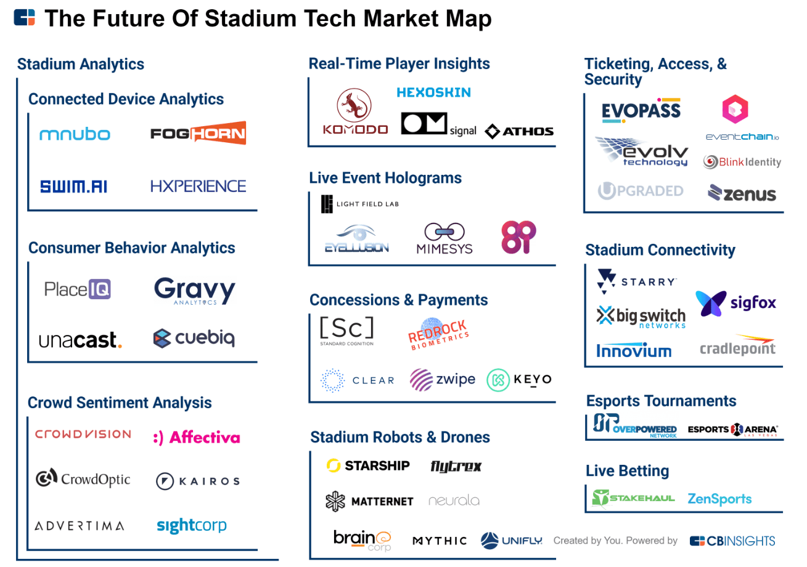
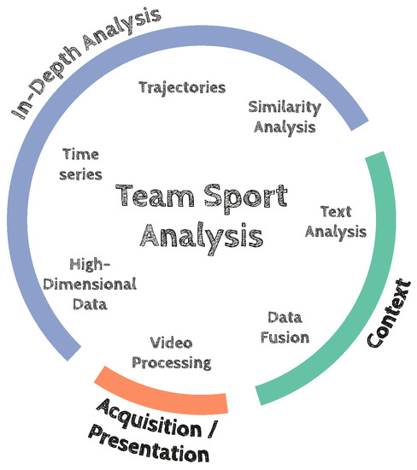
DS in Sports
From predictions, injury prevention, performance enhancements, enhance coaching etc.
www.jigsawacademy.com/beyond-moneyball-how-ai-is-transforming-sports/
https://doi.org/10.3390/data2010002
Notes:
Television and online broadcast form the most critical component of sports revenue and also the primary mode of consumption of sports entertainment. It is also an area that has seen massive transformation in the last decade. AI is proving useful to the sports broadcasting industry in many different ways, but perhaps one of the most important ways is by helping them become more efficient and more productive. The best solutions for broadcasters then are not just the ones that use technology to do amazing things, but also those that integrate seamlessly with their operational requirements.

Slide 12

Don’t forget to do week 2 quiz on D2L. You may update your answers given today’s lecture.

